Slide 1
UNIT-V
CODE GENERATION
SCS1303-Compiler Design

Slide 2
Outline
Issues involved in code generation
Register allocation
Conversion of three address code to assembly code using code generation algorithm
  Examples
Procedure for converting assembly code to machine code
Case study .
SCS1303-Compiler Design

Slide 3
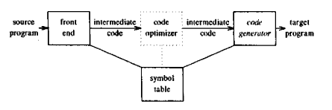
Code Generator
The final phase of our compiler model is the code generator.
It takes as input an intermediate representation of the source program and produces as output an equivalent target program.
SCS1303 Compiler Design

Slide 4
Code generation in reality
The problem of generating an optimal target program is undecidable.
Several subproblems are NP-Hard(such as register allocation).
SCS1303 Compiler Design

Slide 5
Code Generation
The code generated by the compiler is an object code of some lower-level programming language, for example, assembly language.
The source code written in a higher-level language is transformed into a lower-level language that results in a lower-level object code, which should have the following minimum properties:
  It should carry the exact meaning of the source code.
  It should be efficient in terms of CPU usage and memory management.
Output: Intermediate code is transformed into target object code (assembly code, in this case).
SCS1303 Compiler Design

Slide 6
Issues in the Design of a Code Generator
The following issues arise during the code generation phase:
1. Input to code generator
2. Target program
3. Memory management
4. Instruction selection
5. Register allocation
6. Evaluation order
SCS1303 Compiler Design

Slide 7
Input to code generator
The input to the code generation consists of the intermediate representation of the source program produced by front end.
Information in the symbol table that is used to determine run-time addresses of the data objects denoted by the names in the intermediate representation.
Intermediate representation can be :
  Linear representation such as postfix notation
  Three address representation such as quadruples
  Virtual machine representation such as stack machine code
  Graphical representations such as syntax trees and DAGs.
Prior to code generation, the front end must be scanned, parsed and translated into intermediate representation along with necessary type checking. Therefore, input to code generation is assumed to be error-free.
SCS1303 Compiler Design

Slide 8
Target program
The output of the code generator is the target program.
The output may be :
a. Absolute machine language
  It can be placed in a fixed memory location and can be executed immediately.
  A small program can be compiled and executed quickly.
  A number of “student-job” compilers such as WATFIV and PL/C, produce absolute code.
b. Relocatable machine language
  It allows subprograms to be compiled separately.
  A set of relocatable object modules can be linked together and loaded for execution by a linking loader.
SCS1303 Compiler Design

Slide 9
c. Assembly language
  Code generation is made easier.
  Generate symbolic instructions and use the macro facilities of the assembler to help generate code.
  Suitable for machine with a small memory.
SCS1303 Compiler Design

Slide 10
Memory Management
Names in the source program are mapped to addresses of data objects in run-time memory by the front end and code generator.
It makes use of symbol table, that is, a name in a three-address statement refers to a symbol-table entry for the name.
Labels in three-address statements have to be converted to addresses of instructions.
SCS1303 Compiler Design

Slide 11
For example:
J: GOTO I
This generates jump instruction as follows:
  if I < J, a backward jump instruction with target address equal to location of code for quadruple I is generated.
  if I > J, the jump is forward. We must store on a list for quadruple I the location of the first machine instruction generated for quadruple J.
  When I is processed, the machine locations for all instructions that forward jumps to I are filled.
SCS1303 Compiler Design

Slide 12
Instruction selection
The nature of the instruction set of the target machine determines the difference of instruction selection.
The uniformity and completeness of the instructions set are important factors.
Instruction speeds and machine idioms are other important factors when efficiency of target program is considered.
For example:
Every three-address statement of the form
x=y+z
where x, y and z are statically allocated.
MOV y,R0 /* load y into register R0 */
ADD z,R0 /* add z to R0 */
MOV R0,x /* store R0 into x */
SCS1303 Compiler Design

Slide 13
Unfortunately, this kind of statement-by-statement code generation often produces poor code. For example, the sequence of statements,
MOV b,R0
ADD c,R0
MOV R0,a
MOV a,R0
ADD e,R0
MOV R0,d
a = b + c
d = a + e
Translated into
4th statement is redundant
and so is the 3rd if a is
subsequently used.
SCS1303 Compiler Design

Slide 14
The quality of the generated code is determined by its speed and size.
A target machine with a rich instruction set may provide several ways of implementing a given operation.
For example:
  If the target machine has an “increment” instruction(INC), then the three address statement
  a=a+1
  may be implemented more efficiently by the single instruction,
  INC a
  instead of ,
  MOV a,R0
  ADD #1,R0
  MOV R0,a
** Instruction speeds are needed to
design good code sequences, but
accurate timing information is difficult to obtain.
SCS1303 Compiler Design

Slide 15
Register allocation
  Instructions involving register operands are shorter and faster than those involving operands in memory.
  Efficient utilization of registers is important in generating good code.
  The use of registers is subdivided into two sub problems :
  During Register allocation - the set of variables that will reside in registers at a point in the program is selected.
  During a subsequent Register assignment phase - the specific register that a variable will reside in is picked.
Finding an optimal assignment of registers to variables is difficult.
SCS1303 Compiler Design

Slide 16
Certain machine requires even-odd register pairs for some operands and results.
For example , in the IBM System/370 machines integer multiplication and integer division involve register pairs.
Consider the Multiplication instruction is of the form:
M x, y
where,
  x , the multiplicand is the even register of an even/odd register pair.
  The multiplicand value is taken from the odd register of the pair.
  The multiplier y is a single register.
Consider the division instruction of the form :
D x, y
where,
  The 64-bit dividend occupies an even/odd register pair whose even register is x.
  y represents the divisor.
  After division the even register holds the remainder and the odd register the quotient.
SCS1303 Compiler Design

Slide 17
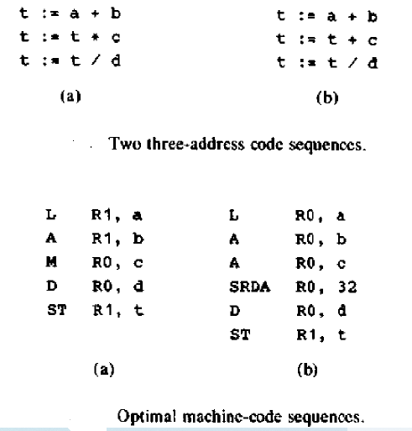
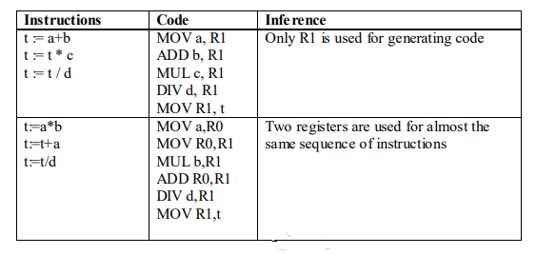
Consider the two three address code sequences, in which only difference is the operator in the second statement.
Ri stands for register i.
SRDA R0,32 shifts the dividend
into R1 and clears R0 so all bits
equal its sign bit.
L , ST and A stand for Load ,Store
and Add respectively.
SCS1303 Compiler Design

Slide 18
Choice of Evaluation order
Ordering of instructions : At last, the code generator decides the order in which the instruction will be executed.
The order in which the computations are performed can affect the efficiency of the target code.
Some computation orders require fewer registers to hold intermediate results than others.
Picking the best order is a difficult task.
Initially avoid this problem by generating code for the three address statements in the order in which they have been produced by the intermediate code generator.
It creates schedules for instructions to execute them.
SCS1303 Compiler Design

Slide 19
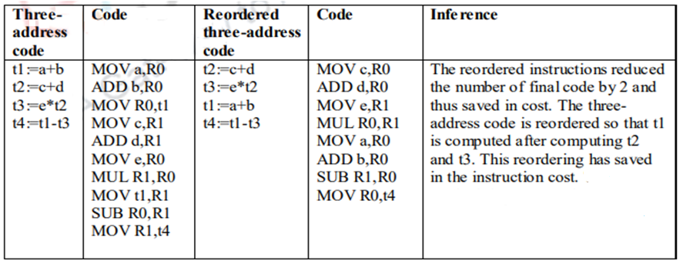
When instructions are independent ,their evaluation order can be changed to utilize registers and save on instruction cost. Consider the following instruction:
a+b-(c+d)*e
The three-address code ,the corresponding code and its reordered instruction are given below:
SCS1303 Compiler Design

Slide 20
Target Machine
Familiarity with the target machine and its instruction set is a prerequisite for designing a good code generator.
The target machine is a register machine that is representative of several minicomputers.
  The target computer is a byte-addressable machine with 4 bytes to a word.
  It has n general-purpose registers, R₀, R₁, . . . , R_{n-1}.
It has two-address instructions of the form:
op source, destination
where,
op is an op-code.
source and destination are data fields.
SCS1303 Compiler Design

Slide 21
Example Opcodes:
    MOV (move source to destination)
    ADD (add source to destination)
    SUB (subtract source from destination)
The source and destination fields are not long enough to hold memory addresses.
The source and destination of an instruction are specified by combining registers and memory locations with address modes.
SCS1303 Compiler Design

Slide 22
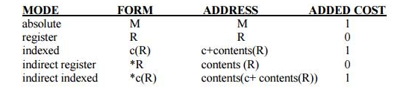
The address modes together with their assembly-language forms and associated costs are as follows:
contents(a) denotes the contents of the register or memory address represented by a.
A memory location M or a register R represents itself when used as a source or destination.
e.g. MOV R0,M → stores the content of register R0 into memory location M.
SCS1303 Compiler Design

Slide 23
An address offset c from the value in register R is written as c(R).
  e.g.
  MOV 4(R0),M → stores the value contents(4+contents(R0)) into memory location M.
  Indirect versions are indicated by prefix *.
  e.g.
  MOV *4(R0) , M → stores the value
  contents(contents(4+contents(R0))) into memory location M.
  A final address mode allows the source to be a constant:
        MODE FORM CONSTANT ADDED COST
        literal #c c 1
    e.g.
    MOV #1, R0 → loads the constant 1 into register R0.
SCS1303 Compiler Design

Slide 24
Instruction costs
The cost of an instruction to be one plus the costs associated with the source and destination address modes.
  Instruction cost = 1+cost for source and destination address modes.
  This cost corresponds to the length of the instruction.
Address modes involving registers have cost zero.
Address modes involving memory location or literal have cost one.
Instruction length should be minimized if space is important. Time taken to fetch an instruction from memory exceeds the time spent executing the instruction.
SCS1303 Compiler Design

Slide 25
For example :
The instruction MOV R0, R1 copies the contents of register R0 into R1. It has cost one, since it occupies only one word of memory.
The (store) instruction MOV R5,M copies the contents of register R5 into memory location M. This instruction has cost two, since the address of memory location M is in the word following the instruction.
The instruction ADD #1,R3 adds the constant 1 to the contents of register 3,and has cost two, since the constant 1 must appear in the next word following the instruction.
The instruction SUB 4(R0),*12(R1) stores the value contents(contents(12+contents(R1)))-contents(contents(4+R0))
into the destination *12(R1).
Cost of this instruction is three, since the constant 4 and 12 are stored in the next two words following the instruction.
SCS1303 Compiler Design

Slide 26
The three-address statement a = b + c can be implemented by many different instruction sequences :
i) MOV b, R0
ADD c, R0
MOV R0, a cost = 6
ii) MOV b, a
ADD c, a cost = 6
iii) Assuming R0, R1 and R2 contain the addresses of a, b, and c :
MOV *R1, *R0
ADD *R2, *R0 cost = 2
iv) Assuming R1 and R2 contain the values of b and c respectively, and that b is not needed after the assignment,
ADD R2,R1
MOV R1,a cost=3
• In order to generate good code for target machine, we must utilize its addressing capabilities efficiently.
SCS1303 Compiler Design

Slide 27
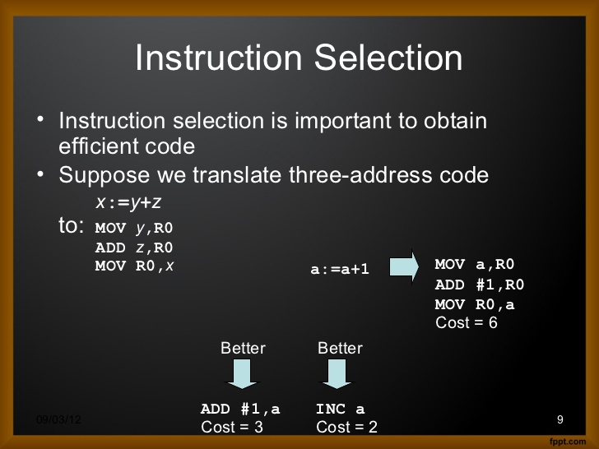
SCS1303 Compiler Design

Slide 28
NEXT TOPIC:
RUN-TIME STORAGE MANAGEMENT
SCS1303-Compiler Design

Slide 29
Introduction
A program as a source code is a collection of text (code, statements etc.) and to make it alive, it requires actions to be performed on the target machine.
A program needs memory resources to execute instructions.
A program contains names for procedures, identifiers etc., that require mapping with the actual memory location at runtime.
Runtime environment is a state of the target machine, which may include software libraries, environment variables, etc., to provide services to the processes running in the system.
Runtime support system is a package which takes care of memory allocation and de-allocation while the program is being executed.
SCS1303 Compiler Design

Slide 30
Storage Allocation
Runtime environment manages runtime memory requirements for the following entities:
  Code : It is known as the text part of a program that does not change at runtime. Its memory requirements are known at the compile time.
  Procedures : Their text part is static but they are called in a random manner. That is why, stack storage is used to manage procedure calls and activations.
  Variables : Variables are known at the runtime only, unless they are global or constant. Heap memory allocation scheme is used for managing allocation and de-allocation of memory for variables in runtime.
SCS1303 Compiler Design

Slide 31
Activation Record
An activation record may contain the following units (depending upon the source language used).
Temporaries | Stores temporary and intermediate values of an expression.
Local Data | Stores local data of the called procedure.
Machine Status | Stores machine status such as Registers, Program Counter etc., before the procedure is called.
Control Link | Stores the address of activation record of the caller procedure.
Access Link | Stores the information of data which is outside the local scope.
Actual Parameters | Stores actual parameters, i.e., parameters which are used to send input to the called procedure.
Return Value | Stores return values.
SCS1303 Compiler Design

Slide 32
Run-Time Storage Management
Information needed during an execution of a procedure is kept in a block of storage called an activation record.
The activation record includes storage for names local to the procedure.
Two standard storage allocation strategies are:
  Static allocation
  Stack allocation
In static allocation, the position of an activation record is fixed in memory at compile time.
In stack allocation, a new activation record is pushed onto the stack for each execution of a procedure. The record is popped when the activation ends.
SCS1303 Compiler Design

Slide 33
Whenever a procedure is executed, its activation record is stored on the stack, also known as control stack.
When a procedure calls another procedure, the execution of the caller is suspended until the called procedure finishes execution.
At this time, the activation record of the called procedure is stored on the stack.
We assume that the program control flows in a sequential manner and when a procedure is called, its control is transferred to the called procedure.
When a called procedure is executed, it returns the control back to the caller. This type of control flow makes it easier to represent a series of activations in the form of a tree, known as the activation tree.
SCS1303 Compiler Design

Slide 34
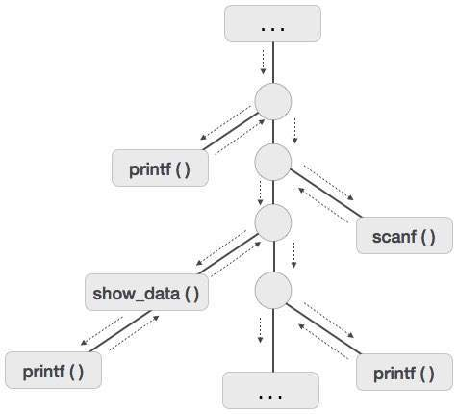
To understand this concept, we take a piece of code as an example:
Activation tree
. . .
printf(“Enter Your Name: “); scanf(“%s”, username); show_data(username);
printf(“Press any key to continue…”);
. . .
int show_data(char *user)
{
printf(“Your name is %s”, username);
return 0;
}
. . .
SCS1303 Compiler Design

Slide 35
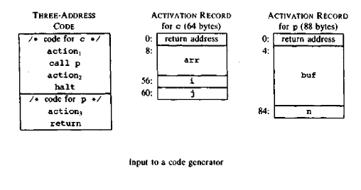
For the run-time allocation and deallocation of activation records the following three-address statements are associated:
  Call
  Return
  Halt
  Action, a placeholder for other statements
We assume that the run-time memory is divided into areas for:
  Code
  Static data
  Stack
SCS1303 Compiler Design

Slide 36
Static allocation
In this allocation scheme, the compilation data is bound to a fixed location in the memory and it does not change when the program executes.
As the memory requirement and storage locations are known in advance, runtime support package for memory allocation and de-allocation is not required.
SCS1303 Compiler Design

Slide 37
Static allocation
1. Implementation of call statement:
The following code is needed to implement static allocation:
MOV #here + 20, callee.static_area /*it saves return address*/
GOTO callee.code_area /* It transfers control to the target code for the call- -ed procedure*/
where,
callee.static_area -refers to the address of the activation record.
callee.code_area -refers to the address of the first instruction for
called procedure.
#here + 20 - literal return address –address of the instruction following GOTO instruction.
SCS1303 Compiler Design

Slide 38
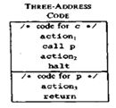
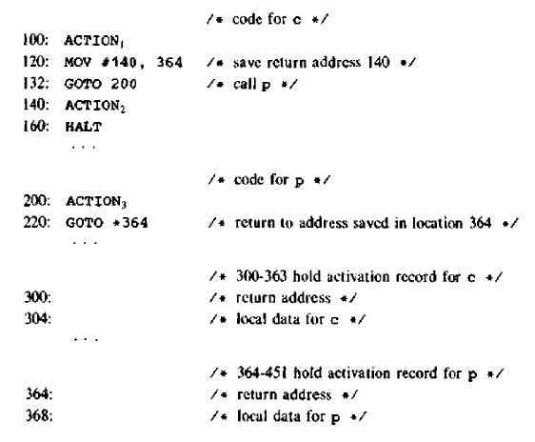
A return from procedure callee is implemented by
GOTO *callee.static_area
which transfers control to the address saved at the beginning of the activation record.
SCS1303 Compiler Design

Slide 39
Stack allocation
Using the relative address, static allocation can become stack allocation for storage in activation records.
The position of the record for an activation of a procedure is not known until run time.
In stack allocation, register is used to store the position of activation record so words in activation records can be accessed as offsets from the value in this register.
The indexed address mode of target machine is used for this purpose.
Relative addresses in an activation record can be taken as offsets from any known position in the activation record.
Procedure calls and their activations are managed by means of stack memory allocation. It works in last-in-first-out (LIFO) method and very useful for recursive procedure calls.
SCS1303 Compiler Design

Slide 40
Positive offsets are used by maintaining a register SP ,a pointer to the beginning of the activation record on top of the stack.
When a procedure call occurs, the calling procedure increments SP and transfers control to the called procedure.
After control returns to the caller, it decrements SP, thereby deallocating the activation record of the called procedure.
SCS1303 Compiler Design

Slide 41
The following code is needed to implement stack allocation:
1. Initialization of stack:
MOV #stackstart , SP /*initializes stack*/
code for the first procedure
HALT /*terminate execution*/
2. Implementation of Call statement :
A procedure call sequence increments SP, saves the return address and transfer control to the called procedure:
ADD #caller.recordsize, SP
MOV #here+16, *SP /*Save return address */
GOTO callee.code_area
The attribute caller.recordsize represents the size of an activation record ,so the ADD instruction leaves SP pointing to the beginning of the next activation record.
SCS1303 Compiler Design

Slide 42
3. Implementation of Return statement:
The return sequence consist of two parts:
1. The called procedure transfers control to the return address using
GOTO *0 ( SP ) /*return to the caller */
The reason for using *0(SP) in the GOTO instruction needs two levels of indirection:
  0(SP) – is the address of the first word in the activation record.
  *0(SP) – is the return address.
2. The second part of the return sequence is in the caller ,which decrements SP, thereby restoring SP to its previous value.
SUB #caller.recordsize , SP
After the subtraction SP points to the beginning of the activation record of the caller.
SCS1303 Compiler Design

Slide 43
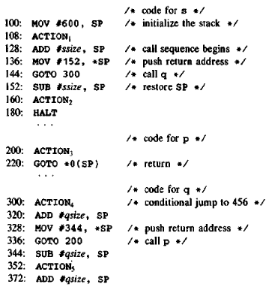
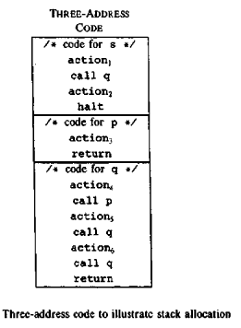
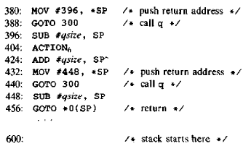
SCS1303 Compiler Design

Slide 44
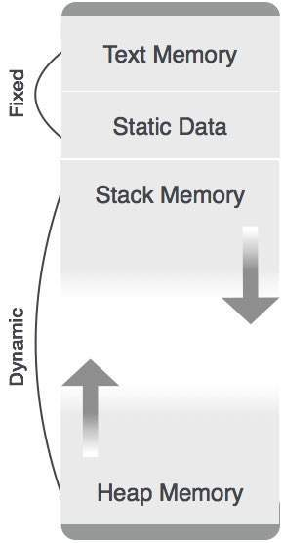
Heap Allocation
Variables local to a procedure are allocated and de-allocated only at runtime.
Heap allocation is used to dynamically allocate memory to the variables and claim it back when the variables are no more required.
Except statically allocated memory area, both stack and heap memory can grow and shrink dynamically and unexpectedly.
Therefore, they cannot be provided with a fixed amount of memory in the system.
SCS1303 Compiler Design

Slide 45
NEXT TOPIC:
NEXT-USE INFORMATION
SCS1303-Compiler Design

Slide 46
Next-Use Information
Collection of next-use information about names in basic blocks.
If the name in a register is no longer needed, then the register can be assigned to some other name.
Computing next-use:
The use of a name in a three-address statement is defined as follows:
  Suppose 3AC i assigns a value to x.
  If statement j has x as an operand and control can flow from statement i to j along a path that has no intervening assignments to x ,then we say statement j uses the value of x computed at i.
SCS1303 Compiler Design

Slide 47
Next-use information is needed for dead-code elimination and register allocation.
Next-use is computed by a backward scan of a basic block.
The next-use information will indicate the statement number at which a particular variable that is defined in the current position will be reused.
SCS1303 Compiler Design

Slide 48
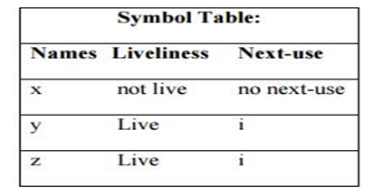
NEXT-USE INFORMATION
Input: Basic block B of three-address statements
Output: At each statement i: x= y op z, we attach to i the liveliness and next-uses of x, y and z.
Method: We start at the last statement of B and scan backwards.
  Attach to statement i the information currently found in the symbol table regarding the next-use and liveliness of x, y and z.
2. In the symbol table, set x to “not live” and “no next use”.
3. In the symbol table set y and z to “live” and next use of y and z to i. Note that the order of steps (2) and (3) may not be interchanged because x may be y or z.
If 3AC i is of the form x=y or x=op y ,the steps are the same as above ,ignoring z.
SCS1303 Compiler Design

Slide 49
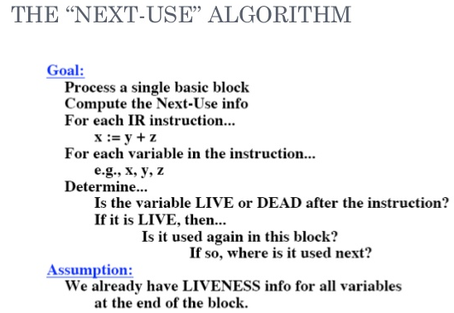
SCS1303 Compiler Design

Slide 50
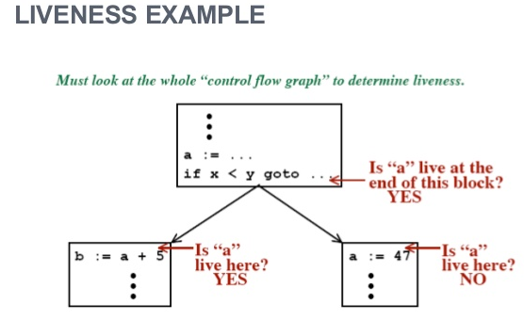
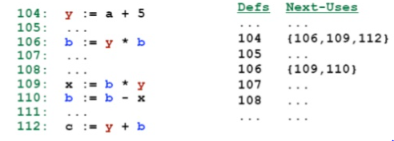
Examples
SCS1303 Compiler Design

Slide 51
Table gives an example sequence of instructions and their nextuse and liveness computation.
Consider statement ‘i' precedes statement ‘j’. We start computing the information from statement ‘j’
Stmt. No. | Instructi--on | Liveness and Nextuse initialized | Modified liveness & next use after stmt ‘j’ | Modified liveness and nextuse after statement ‘i’ | Comments
i | a := b + c | live(a) = true, live(b) = true, live(t) = true, nextuse(a) = none, nextuse(b) = none, nextuse(t) = none | live(a) = true nextuse(a) = j live(b) = true nextuse(b) = j live(t) = false nextuse(t) = none | live(a) = false nextuse(a) = none live(b) = true nextuse(b) = i live(c) = true nextuse(c) = i live(t) = false nextuse(t) = none | ‘a’ is said to false and no nextuse. ‘b’ and ‘c’ are said to live at statement ‘i’ and their next use is at ‘i’ . ‘t’’s liveness and nextuse remains as it is computed in statement ‘j’
j | t := a + b | live(a) = true, live(b) = true, live(t) = true, nextuse(a) = none, nextuse(b) = none, nextuse(t) = none | live(a) = true nextuse(a) = j live(b) = true nextuse(b) = j live(t) = false nextuse(t) = none | live(a) = true nextuse(a) = j live(b) = true nextuse(b) = j live(t) = false nextuse(t) = none | ‘a’ and ‘b’ are used here and hence their nextuse is at ‘j’ and they are said to be live. ‘t’ is computed and hence nextuse is none and live information is false
SCS1303 Compiler Design

Slide 52
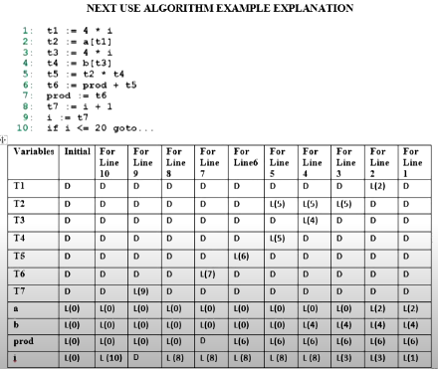
SCS1303 Compiler Design

Slide 53
NEXT TOPIC:
REGISTER ALLOCATION AND ASSIGNMENT
SCS1303-Compiler Design

Slide 54
Register Allocation and Assignment
Registers play a vital role in processor speed as the instructions involving register operands are shorter and faster than memory operands.
Assign specific values on target program to certain registers, i.e., arithmetic computations to some registers, assigning base addresses to some group of registers ,the top of runtime stack to a fixed register etc.
Advantage:
  It simplifies the design of code generator.
Disadvantage:
  Inefficient use of registers: certain registers may go unused over substantial portion of code, while unnecessary loads and stores are generated.
SCS1303 Compiler Design

Slide 55
Register allocation requires next-use information, i.e. for each reference to x we need to know if x’s value will be used further on in the program.
We also need to keep track of what’s in each register. This is sometimes called register tracking.
We need a register allocator, a routine that picks registers to hold the contents of intermediate computations.
SCS1303 Compiler Design

Slide 56
Local register allocation
  Register allocation is only within a basic block. It follows top-down approach.
  Assign registers to the most heavily used variables.
  Traverse the block.
  Count uses.
  Use count as a priority function.
  Assign registers to higher priority variables first.
SCS1303 Compiler Design

Slide 57
Need of global register allocation:
Local allocation does not take into account that some instructions (e.g. those in loops) executed more frequently. It forces us to store/load at basic block endpoints since each block has no knowledge of the context of others.
To find out the live range(s) of each variable and the area(s) where the variable is used/defined global allocation is needed.
One strategy for global allocation is to assign some fixed number of registers to hold the most active values in each inner loop.
Register allocation depends on:
  Size of live range
  Number of uses/definitions
  Frequency of execution
  Number of loads/stores needed.
  Cost of loads/stores needed.
SCS1303 Compiler Design

Slide 58
Usage counts:
A simple method for determining the savings to be realized by keeping variable x in a register for the duration of loop L.
If x is already in a register, then one unit of cost is saved for each reference.
If x is live variable at the end of block, then it saves two units of cost by avoiding a load(one unit) and a store(one unit) of the variable concerned.
If x is live on loop header, x must be loaded into register before entering into the loop(two unit).
Similarly, for each exit block of loop L, at which x is live on entry to some successor of B outside of L, x must be stored at a cost of two.
SCS1303 Compiler Design

Slide 59
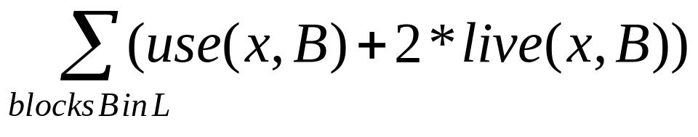
An approximate formula for the benefit to be realized from allocating a register to x within loop L is:
where,
  use(x,B) →number of times x is used in B prior to any definition of x.
  live(x, B) →
Eq.1
1 if x is live on exit from B and is assigned a value in B
0 Otherwise
SCS1303 Compiler Design

Slide 60
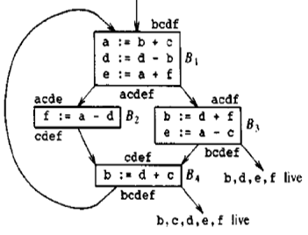
Example
Assume registers R0,R1 and R2 are allocated to hold values throughout the loop.
Variables live on entry into and on exit from each block is shown in the figure.
SCS1303 Compiler Design

Slide 61
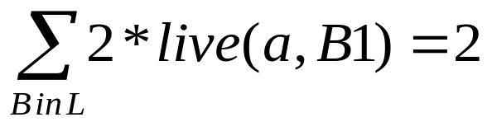
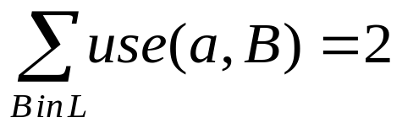
To evaluate the equation (1), for x=a:
  a is live on exit from B1 and is assigned a value there, but it is not live on exit from B2,B3 or B4.
  use(a,B1)=0,since a is used after its definition.
  use(a,B2)=use(a,B3)=1and use(a,B4)=0.
  Hence the value of equation (1) for x=a is 4.
  i.e. four units of cost can be saved by selecting a for one of the global registers.
SCS1303 Compiler Design

Slide 62
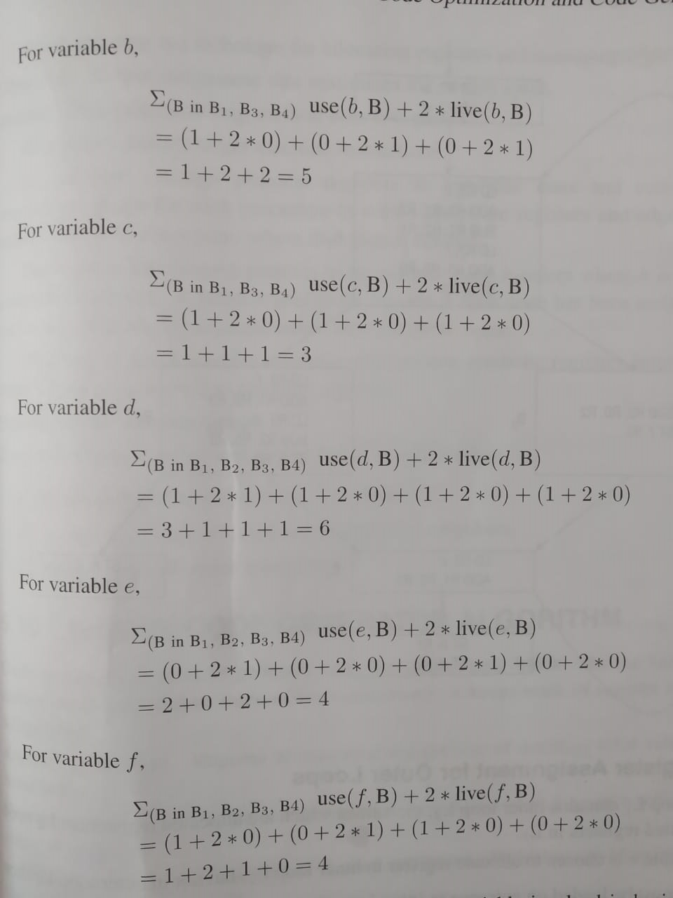
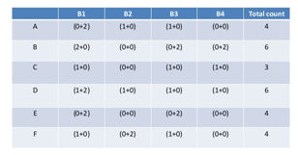
Thus select a, b and d for registers R0,R1 and R2 respectively.
SCS1303 Compiler Design

Slide 63
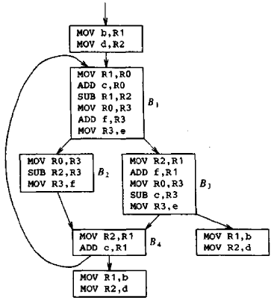
The figure shows the assembly code generated for the given example.
SCS1303 Compiler Design

Slide 64
Register allocation by graph coloring
When a register is needed for a computation but all available registers are in use, the contents of one of the used registers must be stored(spilled) into a memory location in order to free up a register.
Graph coloring is a simple, systematic technique for allocating registers and managing register spills.
This method uses two pass:
First pass:
  Target machine instructions are selected ,assuming there are infinite number of symbolic registers.
  Names used in the intermediate code becomes names of registers and the three address statements become machine statements.
SCS1303 Compiler Design

Slide 65
Spilling
A “spilled variable” is a variable in main memory rather than in a CPU register. The operation of moving a variable from a register to memory is called spilling, while the reverse operation of moving a variable from memory to a register is called filling.
SCS1303 Compiler Design

Slide 66
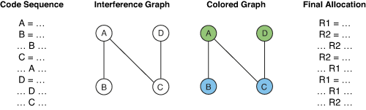
Second pass:
  Once instructions have been selected, a second pass assigns physical registers to symbolic ones.
  The goal is to find an assignment that minimizes the cost of the spills.
  For each procedure a register-interference graph is constructed in which the nodes are symbolic registers and an edge connects two nodes if one is live at a point where the other is defined.
SCS1303 Compiler Design

Slide 67
Register allocation by graph coloring
Global register allocation can be seen as a graph coloring problem.
Basic idea:
1. Identify the live range of each variable
2. Build an interference graph that represents conflicts between live ranges (two nodes are connected if the variables they represent are live at the same moment)
3. Try to assign as many colors to the nodes of the graph as there are registers so that two neighbors have different colors.
SCS1303 Compiler Design

Slide 68
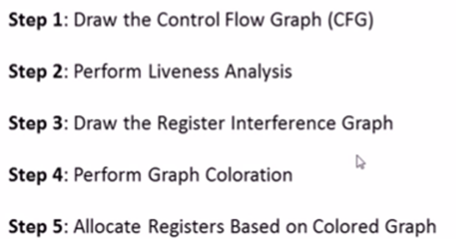
Given a program code ,how to perform register allocation
by graph coloration?
SCS1303 Compiler Design

Slide 69
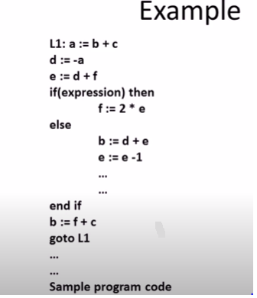
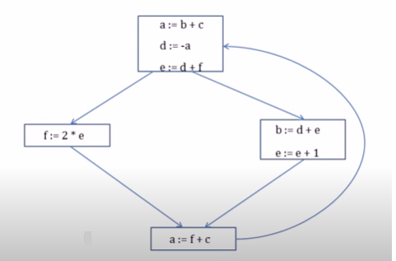
SCS1303 Compiler Design

Slide 70
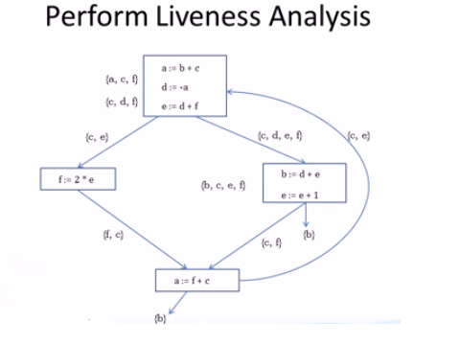
Liveness analysis is procedure to determine which set of variables are live at each point in the program.
SCS1303 Compiler Design

Slide 71
NEXT TOPIC:
A SIMPLE CODE GENERATOR
SCS1303-Compiler Design

Slide 72
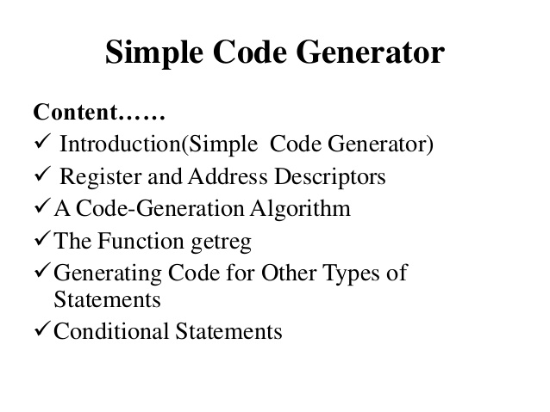
SCS1303 Compiler Design

Slide 73
We assume that computed results can be left in registers as long as possible.
How to use registers:
  Some or all operands of an operation must be in registers to perform operation.
  Register make good temporaries place to hold results of sub expression while larger expression is evaluated.
  Registers are used to hold global values that are computed in one basic blocks and used in another.
  Registers are often used to help with runtime storage management.
SCS1303 Compiler Design

Slide 74
A Simple Code Generator
If the name in a register is no longer needed, then we remove the name from the register and the register can be used to store some other names.
A code generator generates target code for a sequence of three- address statements and effectively uses registers to store operands of the statements.
For example: Consider the three-address statement a := b+c .
It can have the following sequence of codes:
    ADD Rj, Ri Cost = 1
    (or)
    ADD c, Ri Cost = 2
    (or)
    MOV c, Rj Cost = 3
    ADD Rj, Ri
SCS1303 Compiler Design

Slide 75
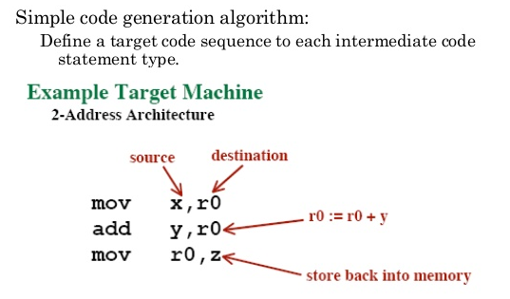
SCS1303 Compiler Design

Slide 76
Register and Address Descriptors
The code-generation algorithm uses descriptors to keep track of register contents and addresses for names.
A register descriptor is used to keep track of what is currently in each registers. The register descriptors show that initially all the registers are empty.
As the code generation for the block progresses, each register will hold the value of zero or more names at any given time.
An address descriptor keeps track of the location where the current value of the name can be found at run time. The location might be a register, a stack location , a memory address etc.
SCS1303 Compiler Design

Slide 77
If the value of a name is found at more than one place (register, cache, or memory), the register’s value will be preferred over the cache and main memory.
getReg : Code generator uses getReg function to determine the status of available registers and the location of name values. getReg works as follows:
  If variable Y is already in register R, it uses that register.
  Else if some register R is available, it uses that register.
  Else if both the above options are not possible, it chooses a register that requires minimal number of load and store instructions.
SCS1303 Compiler Design

Slide 78
A code-generation algorithm:
The algorithm takes as input a sequence of three-address statements constituting a basic block. For each three-address statement of the form x : = y op z, perform the following actions:
  Invoke a function getreg to determine the location L where the result of the computation y op z should be stored. L will usually be a register ,but it could also be a memory location.
  Consult the address descriptor for y to determine y‘ , the current location of y. Prefer the register for y’ if the value of y is currently both in memory and a register. If the value of y is not already in L, generate the instruction MOV y’ , L to place a copy of y in L.
SCS1303 Compiler Design

Slide 79
3. Determine the present location of z using the same method used in step 2 for y and generate the following instruction:
OP z’, L
where z’ represents the copied value of z.
4. Now L contains the value of y OP z, that is intended to be assigned to x. So, if L is a register, update its descriptor to indicate that it contains the value of x. Update the descriptor of x to indicate that it is stored at location L.
5. If y and z has no further use, they can be given back to the system.
SCS1303 Compiler Design

Slide 80
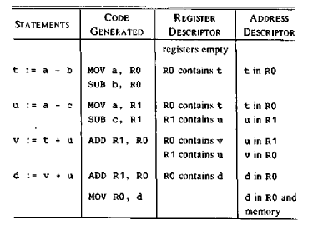
Generating Code for Assignment Statements:
The assignment d : = (a-b) + (a-c) + (a-c) might be translated into the following three-address code sequence:
Code sequence for the example is:
t = a - b
u = a - c
v = t + u
d = v + u
SCS1303 Compiler Design

Slide 81
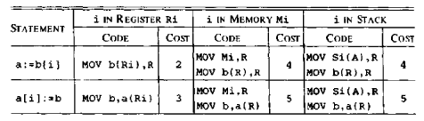
Generating Code for Indexed Assignments
The sequences generated for the indexed assignment a:= b[ i ] and a[ i ]:= b
The current location of i determines the code sequence .three cases are covered depending on:
  whether i is in register Ri
  whether i is in memory location Mi
  whether i is on the stack at offset Si and the pointer to the activation record for i is in register A.
The register R is returned when function getreg is called.
SCS1303 Compiler Design

Slide 82
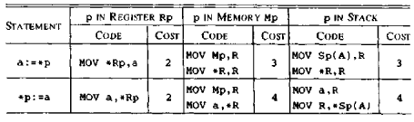
Generating Code for Pointer Assignments
The code sequences generated for the pointer assignments a : = *p and *p : = a
The current location of p determines the code sequence .three cases are covered depending on:
  whether p is in register Rp
  whether p is in memory location Mp
  whether p is on the stack at offset Sp and the pointer to the activation record for p is in register A.
The register R is returned when function getreg is called.
SCS1303 Compiler Design

Slide 83
Conditional Statements
Machines implement conditional jumps in one of two ways.
  Branch if the value of a designated register meets one of the six conditions: zero, positive, nonnegative, nonzero and nonpositive.
    i.e. if x<y goto z can be implemented by subtracting y from x in register R and then jumping to z if the value in register R is negative.
    2. Uses a set of condition codes to indicate whether the last quantity computed or loaded into a register is negative, zero or positive.
    i.e. CMP x,y sets the condition code to positive if x>y and so on.
    The instruction CJ<=z used to mean “ jump to z if the condition code is negative or zero”
SCS1303 Compiler Design

Slide 84
Example
If x<y goto z could be implemented by
  CMP x , y
  CJ< z
  e.g.
    x = y + z
    if x < 0 goto z
  is implemented by
    MOV y,R0
    ADD z,R0
    MOV R0,x
    CJ< z
SCS1303 Compiler Design

